Slide 1

Variations on pix2pix
Grace Boatman and Trevor Wexner

Slide 2
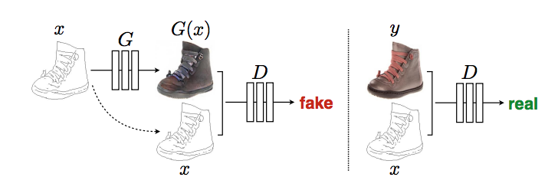
Intro: Goal of pix2pix
Image Transformation via conditional GAN (cGAN)
Image from: https://arxiv.org/pdf/1611.07004.pdf#page=15&zoom=100,0,530

Slide 3
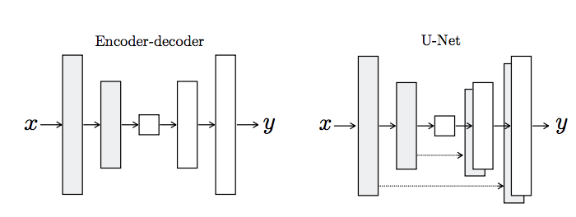
pix2pix: novel contributions from previous cGANs
Generator: Unet
Add in skip connections for faster convergence and better retention of earlier-detected patterns

Slide 4
pix2pix: novel contributions from previous cGANs
Discriminator: PatchGAN
Only penalize at the “patch” level → allows network to be more robust at detecting neighborhood-level patterns
Experiment with different patch sizes (NxN)

Slide 5
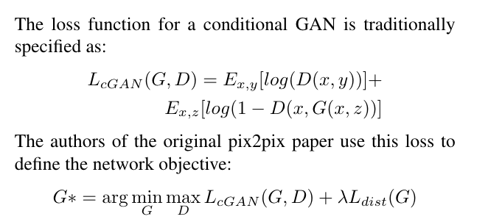
pix2pix: loss function

Slide 6
What we implemented and changed
Implemented the 14-layer UNet generator faithfully (with less harsh dropout)
Experimented with different patch sizes than the authors
Authors use 1x1, 16x16, 70x70, and 286x286
We use 1x1, 70x70, 142x142, and 286x286
Tweaked the distance penalty in the loss function
The authors use cGAN and cGAN + L1
We use cGAN, cGAN + L1, and cGAN + L2

Slide 7
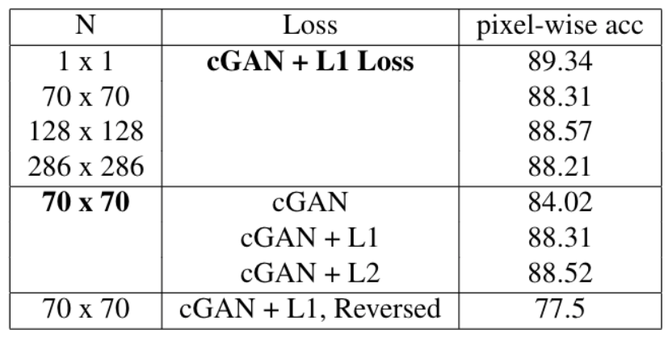

Results: Pixel-Wise Acc

Slide 8
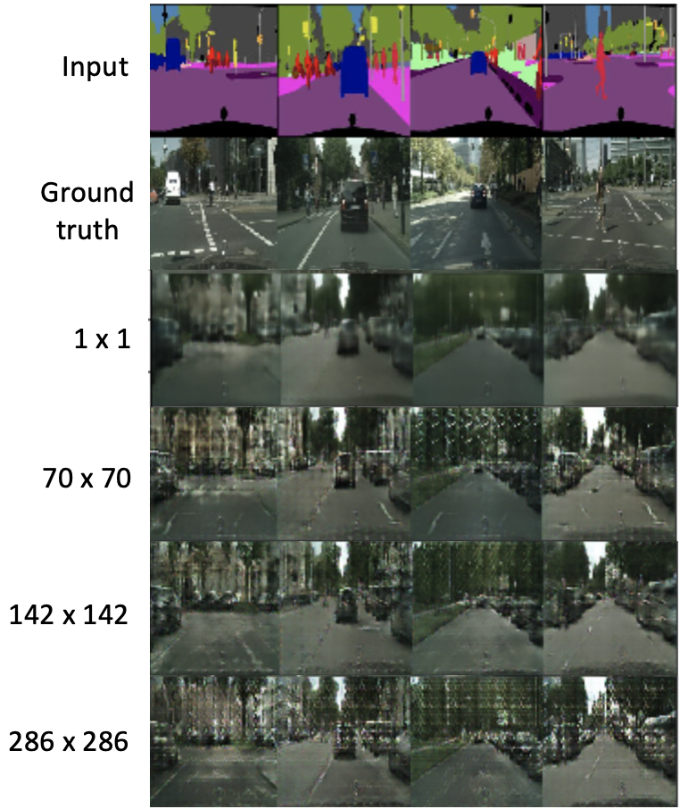
Results: Patch Size

Slide 9
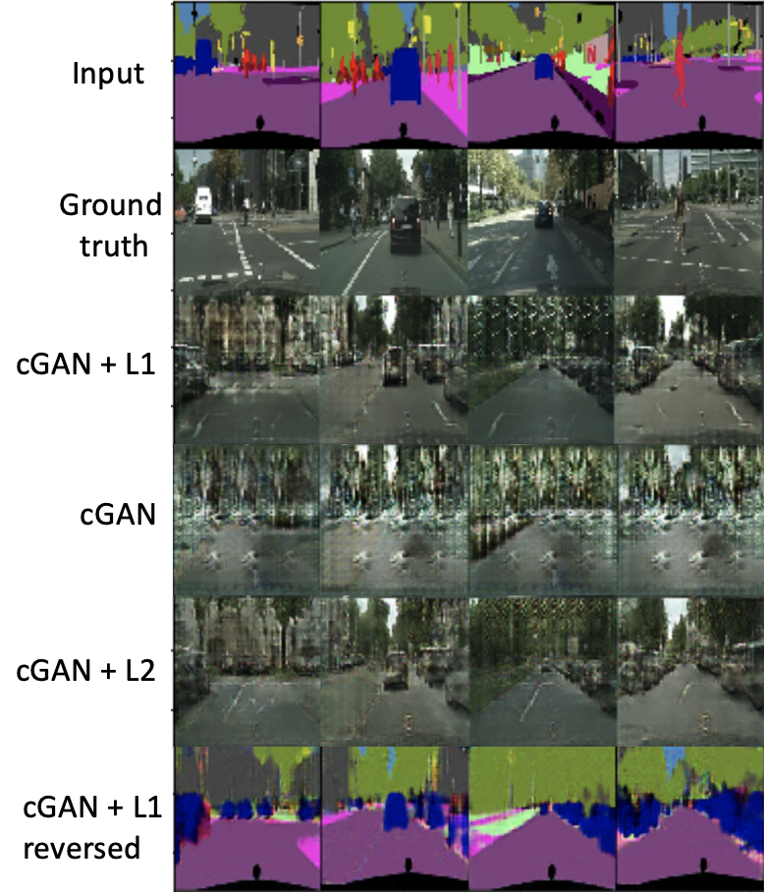
Results: Loss

Slide 10
Future Directions
Two discriminators!

